Slide 1
Principles of diffusion models
2024.09.09~12
허성우

Slide 2
High-level concept

Slide 3
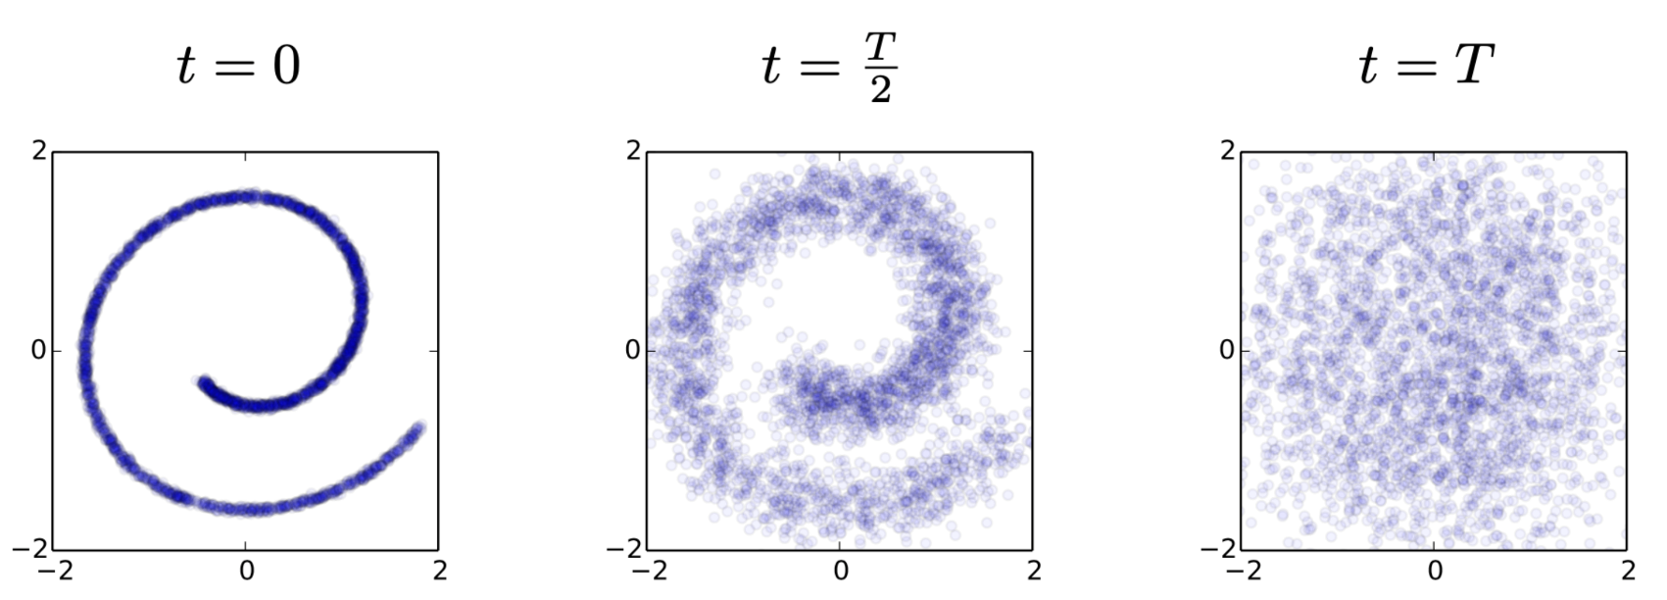
High-level concept
Idea of diffusion models
Diffusion model learns a process that connects a simple distribution (e.g. Gaussian) with a complex one.
To generate samples
Sample from the simple distribution
Transport it to the complex one through the process.

Slide 4
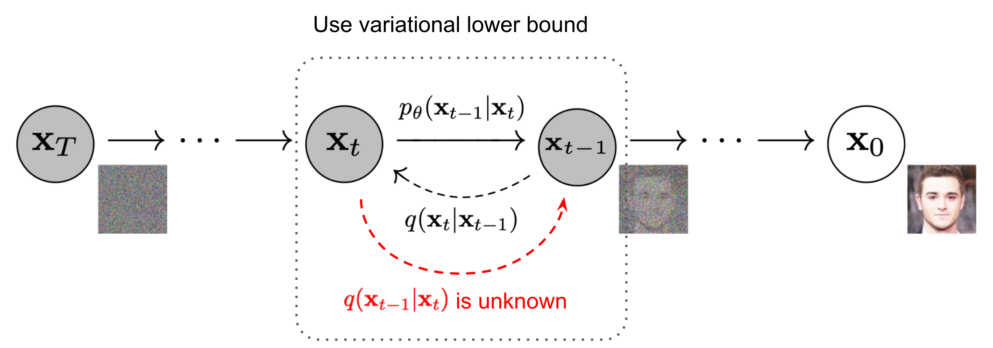
High-level concept
Denoising & nosing process

Slide 5
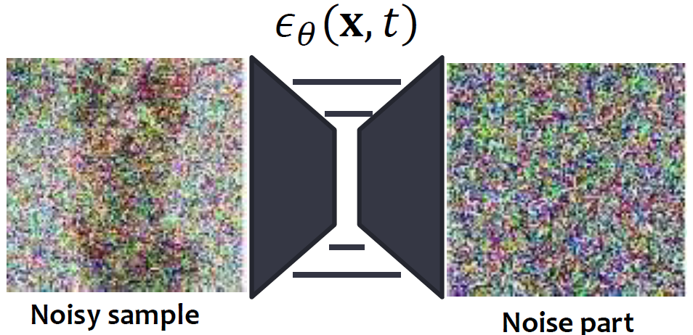
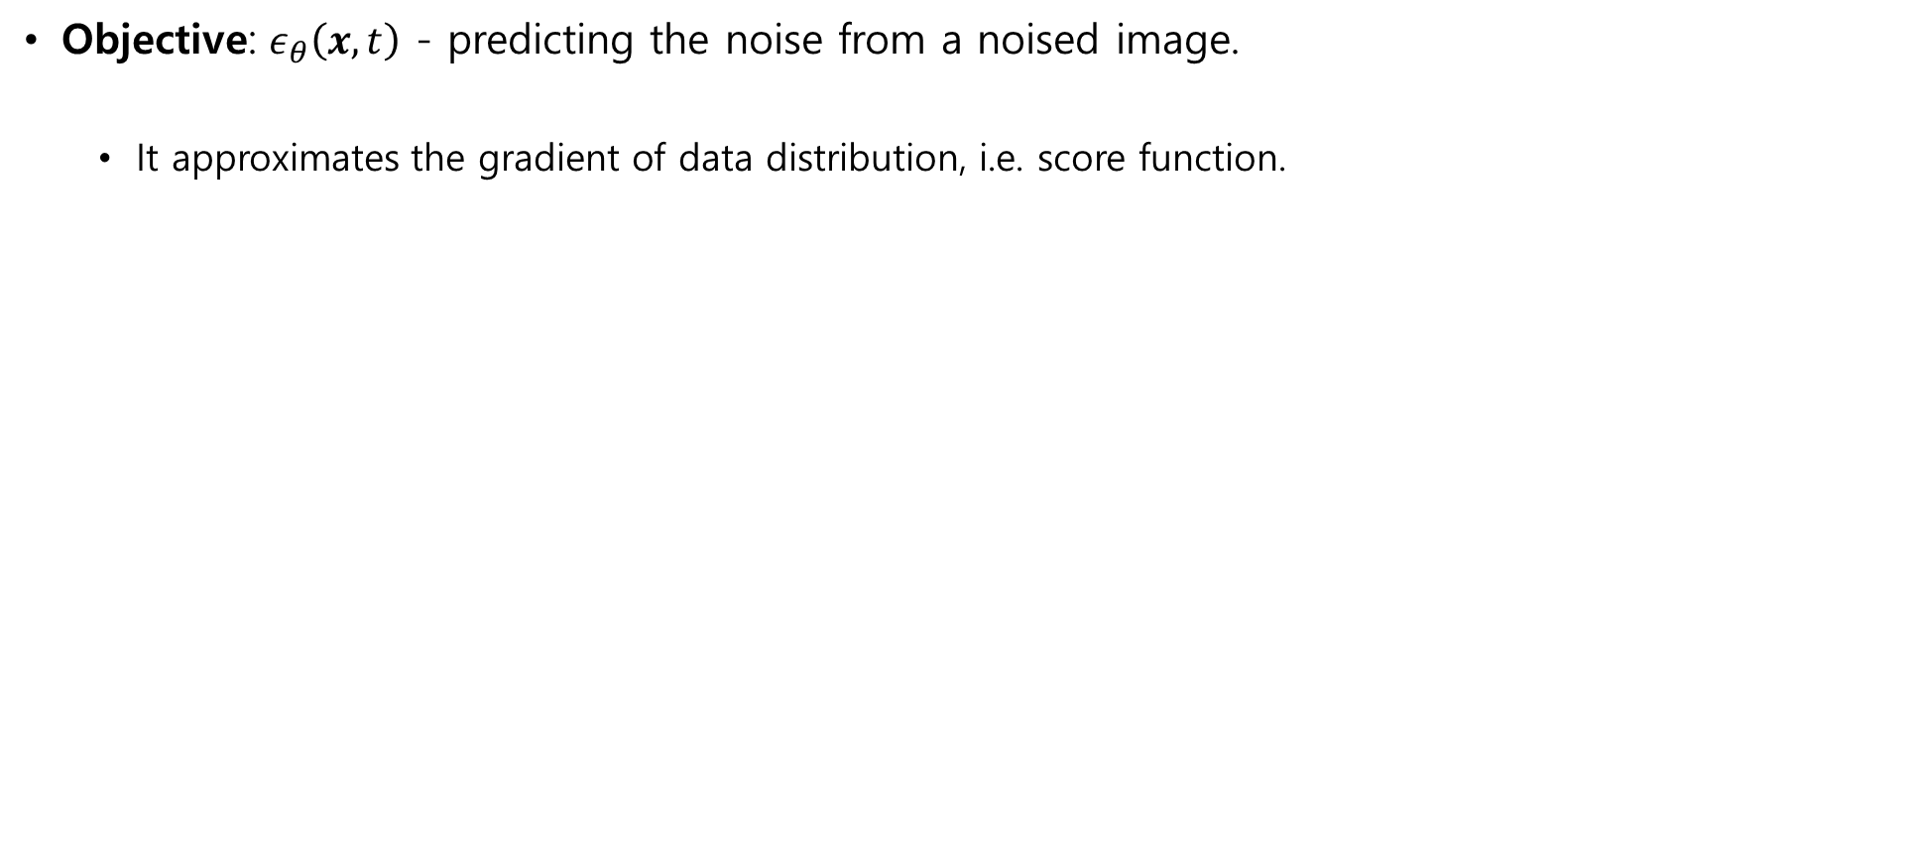
High-level concept
Denoising via neural networks
Objective: $ε_{θ}\left(x, t\right)$ - predicting the noise from a noised image.
It approximates the gradient of data distribution, i.e. score function.

Slide 6
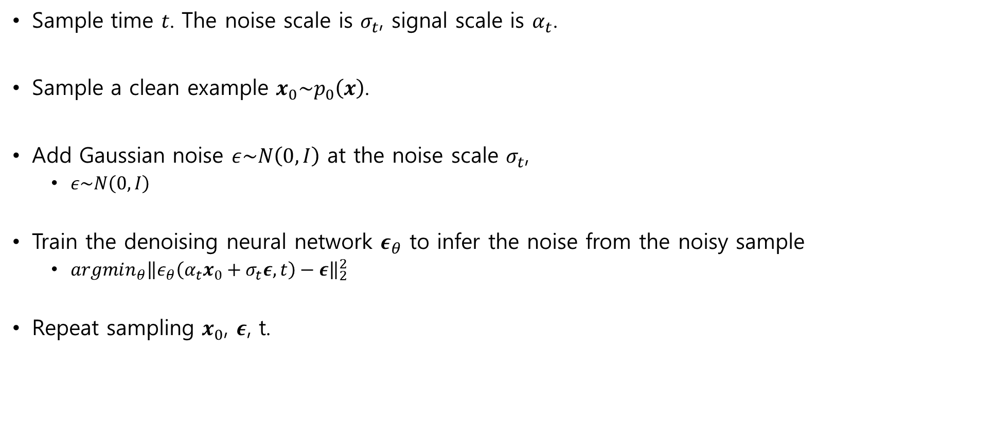
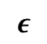
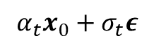
High-level concept
Training Process
Sample time 𝑡. The noise scale is $σ_{t}$, signal scale is $α_{t}$.
Sample a clean example $x_{0}\sim p_{0}\left(x\right)$.
Add Gaussian noise $ε\sim N\left(0, I\right)$ at the noise scale $σ_{t}$,
$ε\sim N\left(0, I\right)$
Train the denoising neural network $ε_{θ}$ to infer the noise from the noisy sample
$argmin_{θ}{\left\|ε_{θ}\left(α_{t}x_{0}+σ_{t}ε,t\right)−ε\right\|}_{2}^{2}$
Repeat sampling $x_{0}$, $ε$, t.
$$α_{t}x_{0}+σ_{t}ε$$
$$ε$$

Slide 7
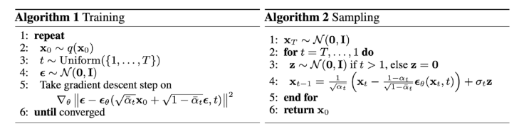
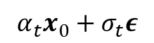
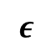
High-level concept
Training Process (DDPM)
Score matching
Sampling (Denoising)
$$α_{t}x_{0}+σ_{t}ε$$
$$ε$$

Slide 8
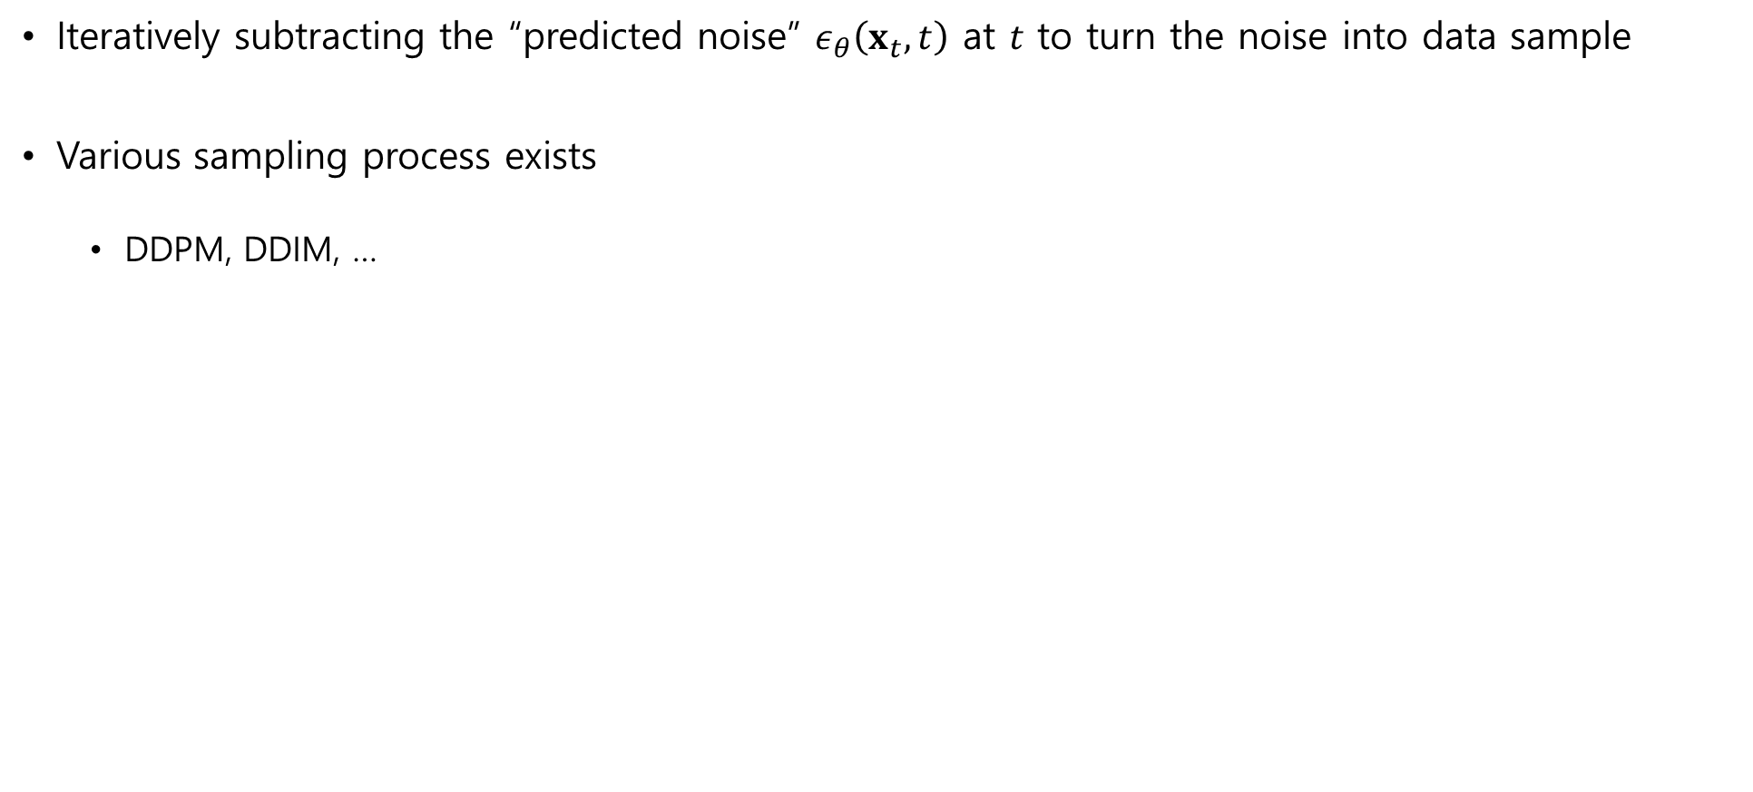
High-level concept
Sampling by Reversing Noising Process
Iteratively subtracting the “predicted noise” $ε_{θ}\left(x_{t},t\right)$ at $t$ to turn the noise into data sample
Various sampling process exists
DDPM, DDIM, …

Slide 9
Math behind diffusion models

Slide 10
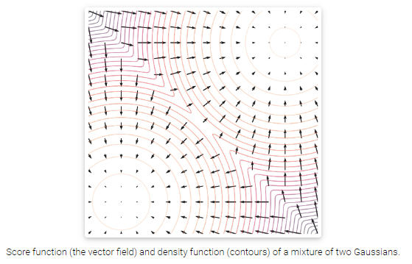
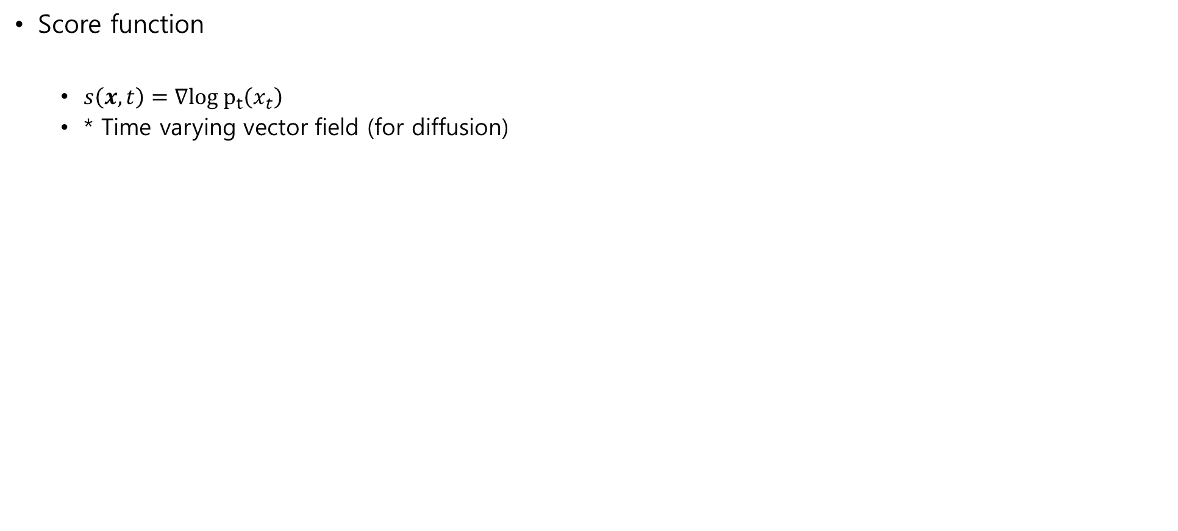
Theoretical justification
Score function
Score function
$s\left(x,t\right)=∇log p_{t}\left(x_{t}\right)$
* Time varying vector field (for diffusion)

Slide 11
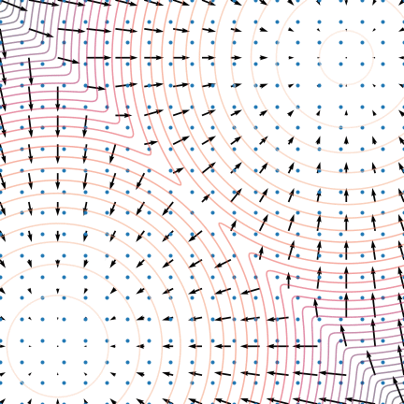

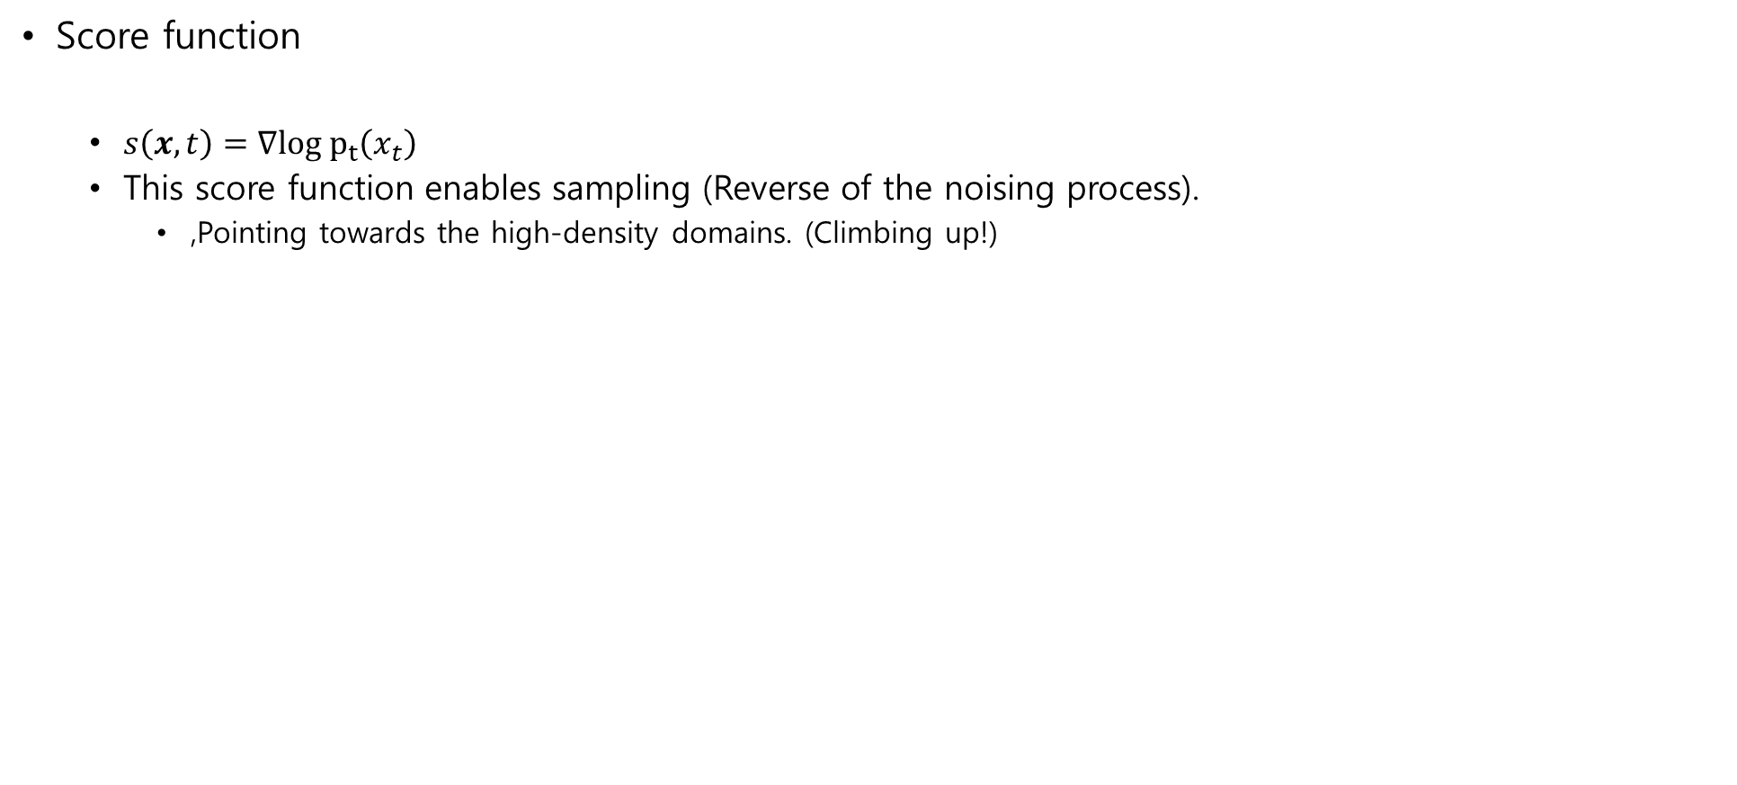
Theoretical justification
Score function
Score function
$s\left(x,t\right)=∇log p_{t}\left(x_{t}\right)$
This score function enables sampling (Reverse of the noising process).
,Pointing towards the high-density domains. (Climbing up!)

Slide 12
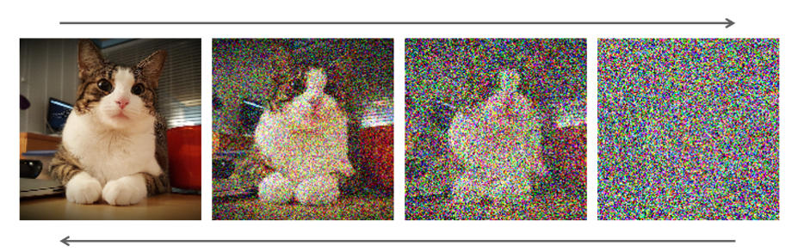
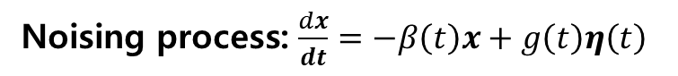
Theoretical justification
Score function
Noising / denoising process
The score function enables sampling
Noising process: $\frac{dx}{dt}=−β\left(t\right)x+g\left(t\right)η\left(t\right)$
Denoising process: $\frac{dx}{dt}=−β\left(t\right)x+g\left(t\right)η\left(t\right)−g{\left(t\right)}^{2}s\left(x,t\right)$
Score function!

Slide 13
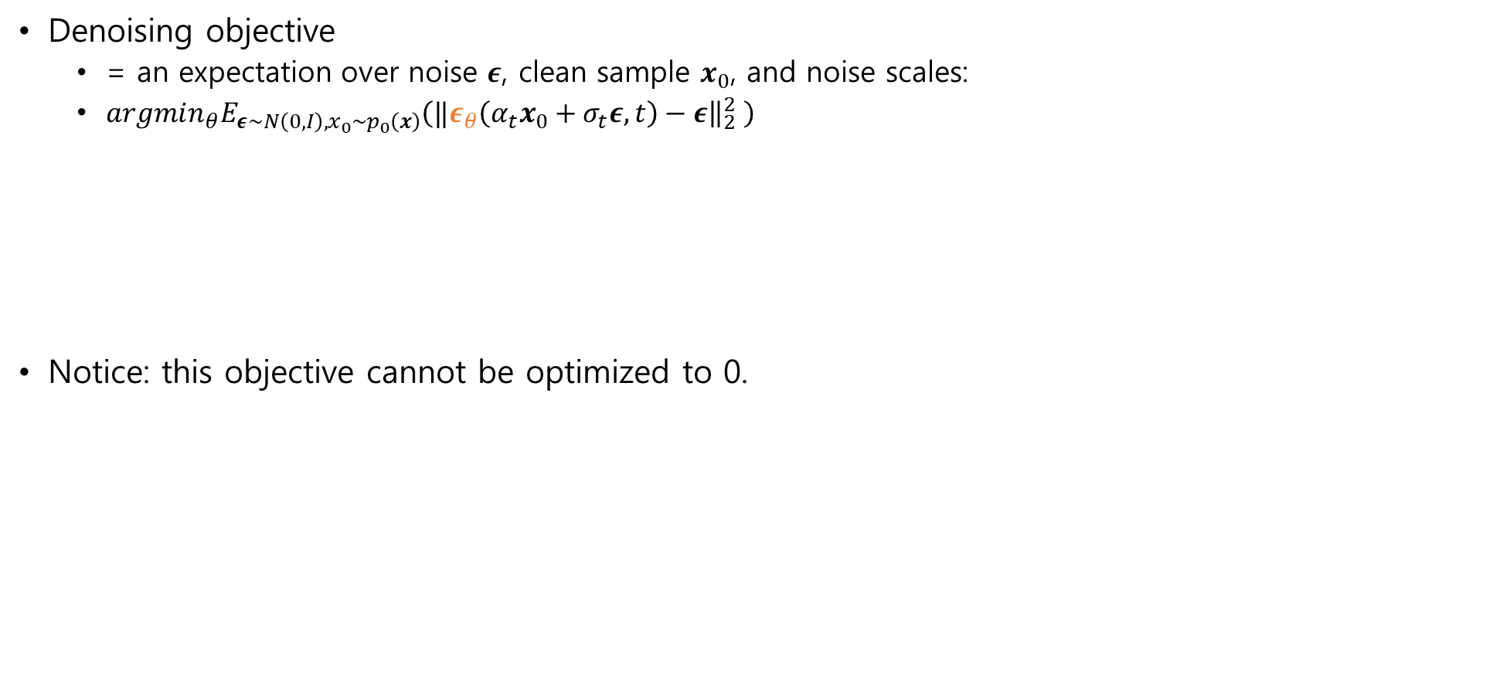
Theoretical justification
Meaning of the denoising objective
Denoising objective
= an expectation over noise $ε$, clean sample $x_{0}$, and noise scales:
$argmin_{θ}E_{ε\sim N\left(0,I\right),x_{0}\sim p_{0}\left(x\right)}\left({‖ε}_{θ}\left(α_{t}x_{0}+σ_{t}ε, t\right)−ε{\left.​\right\|}_{2}^{2} \right)$
Notice: this objective cannot be optimized to 0.
Noised sample
Denoising neural net

Slide 14
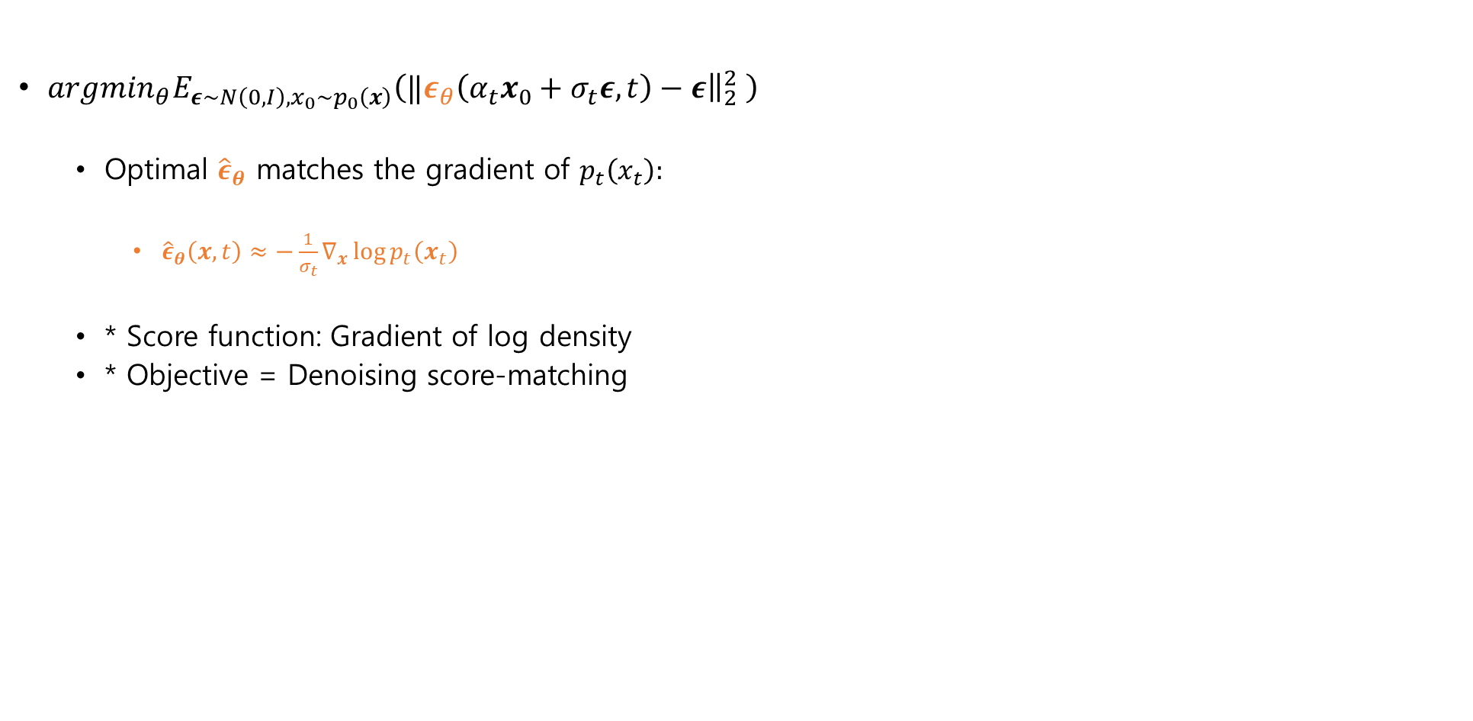
Theoretical justification
Meaning of the denoising objective
$argmin_{θ}E_{ε\sim N\left(0,I\right),x_{0}\sim p_{0}\left(x\right)}\left({‖ε}_{θ}\left(α_{t}x_{0}+σ_{t}ε, t\right)−ε{\left.​\right\|}_{2}^{2} \right)$
Optimal ${\hat{ε}}_{θ}$ matches the gradient of $p_{t}\left(x_{t}\right):$
${\hat{ε}}_{θ}\left(x,t\right)≈−\frac{1}{σ_{t}}∇_{x}\log{p_{t}\left(x_{t}\right)}$
* Score function: Gradient of log density
* Objective = Denoising score-matching

Slide 15
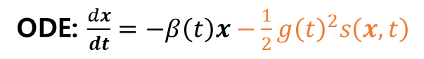
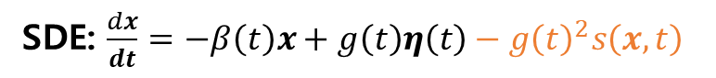
Theoretical justification
Solving ODE / SDE
The denoising process (=sampling) amounts to solving a reverse ODE or SDE
Ordinary Differential Equation (ODE)
Stochastic Differential Equation (SDE)
Advanced SDE or ODE solver (e.g. Runge Kutta) can sample diffusion models efficiently.
ODE: $\frac{dx}{dt}=−β\left(t\right)x−\frac{1}{2}g{\left(t\right)}^{2}s\left(x,t\right)$
SDE: $\frac{dx}{dt}=−β\left(t\right)x+g\left(t\right)η\left(t\right)−g{\left(t\right)}^{2}s\left(x,t\right)$

Slide 16
Conditional diffusion models
Controlling the diffusion process.

Slide 17

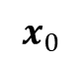
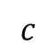
Conditional diffusion models
Conditional diffusion models
We want to generate something like…
But how?
Diffusion models
“Cat astronaut on Mars.”
$$c$$
$$x_{0}$$

Slide 18
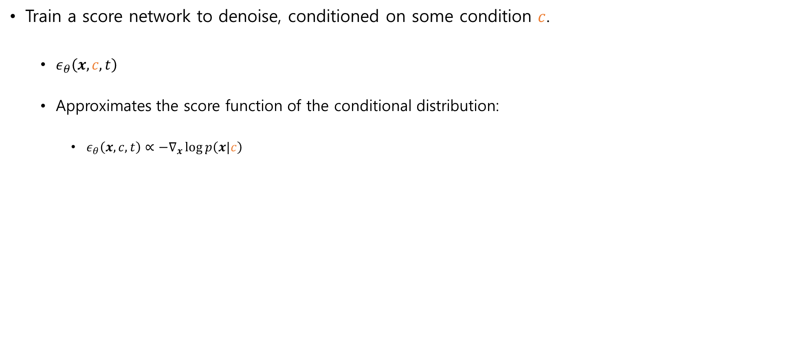
Conditional diffusion models
Conditional diffusion models
Train a score network to denoise, conditioned on some condition $c$.
$ε_{θ}\left(x,c,t\right)$
Approximates the score function of the conditional distribution:
$ε_{θ}\left(x,c,t\right)∝−∇_{x}\log{p\left(x|c\right)}$

Slide 19
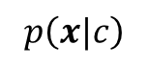
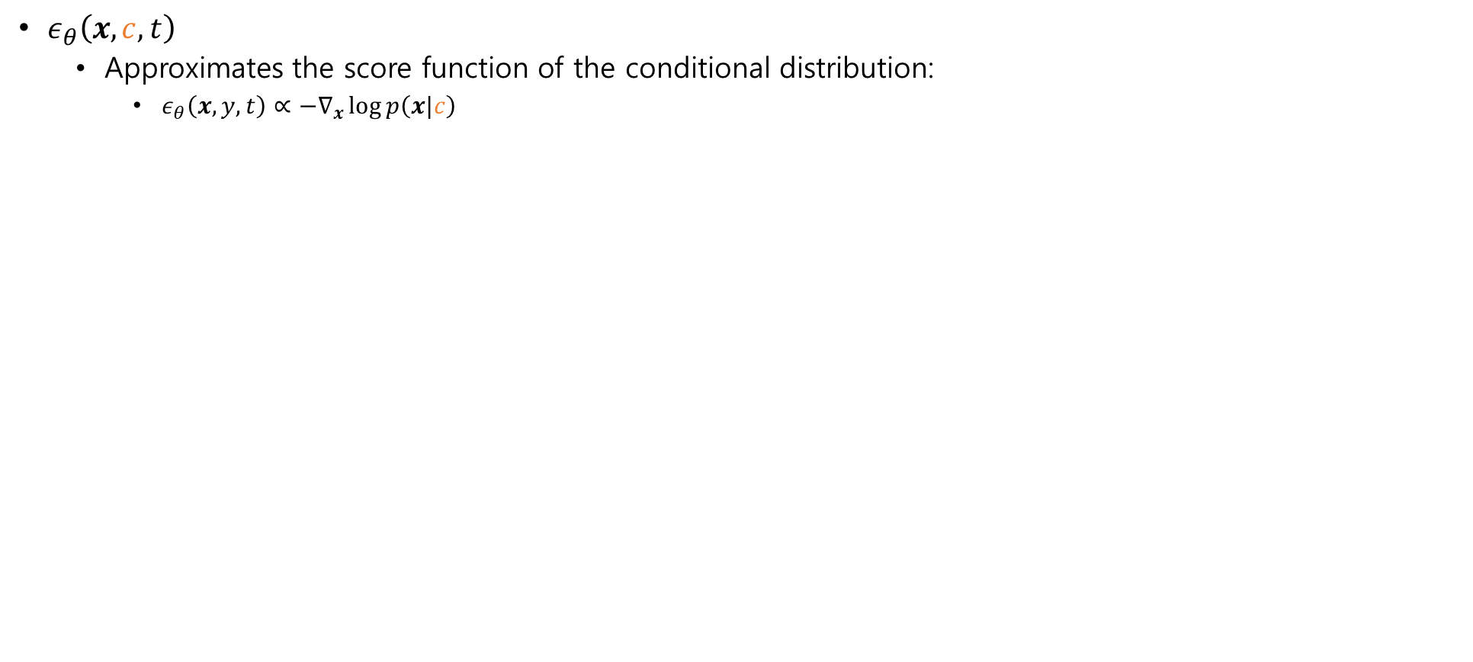


Conditional diffusion models
Conditional diffusion models
$ε_{θ}\left(x,c,t\right)$
Approximates the score function of the conditional distribution:
$ε_{θ}\left(x,y,t\right)∝−∇_{x}\log{p\left(x|c\right)}$
Unconditional $p\left(x\right)$ and score
Conditional $p\left(x|y\right)$ and score
$$p\left(x|c\right)$$

Slide 20
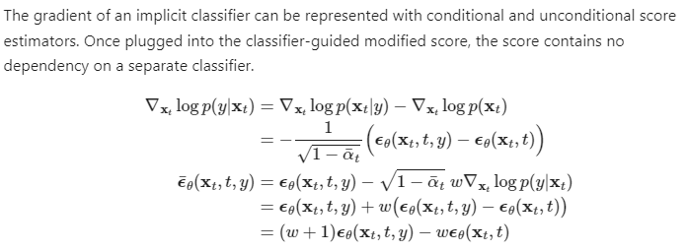
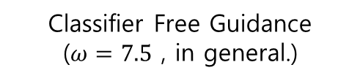

Conditional diffusion models
Classifier Free Guidance (CFG)
In fact, the score function is computed as …
$$c$$
Classifier Free Guidance
($ω=7.5$ , in general.)

Slide 21
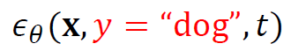
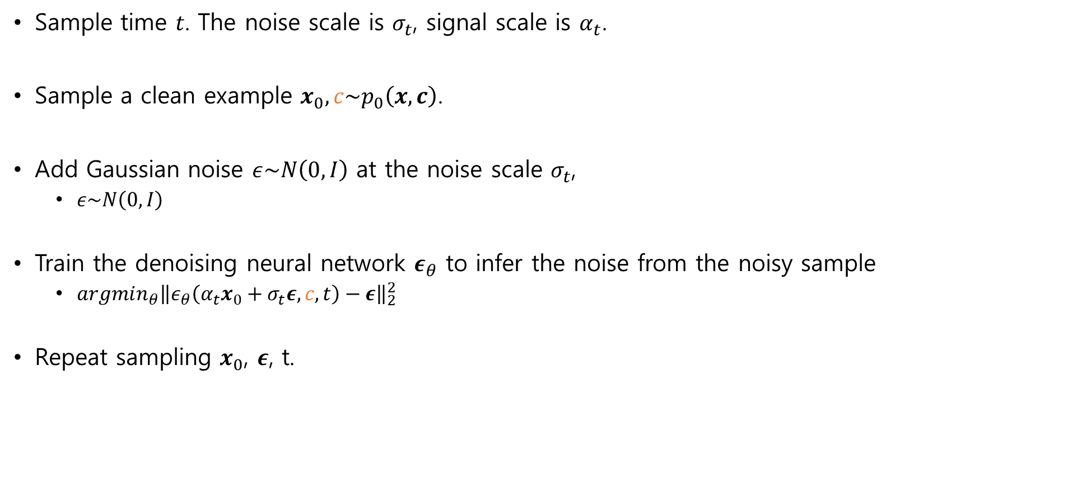
Conditional diffusion models
Training of conditional diffusion models
Sample time 𝑡. The noise scale is $σ_{t}$, signal scale is $α_{t}$.
Sample a clean example $x_{0},c\sim p_{0}\left(x,c\right)$.
Add Gaussian noise $ε\sim N\left(0, I\right)$ at the noise scale $σ_{t}$,
$ε\sim N\left(0, I\right)$
Train the denoising neural network $ε_{θ}$ to infer the noise from the noisy sample
$argmin_{θ}{\left\|ε_{θ}\left(α_{t}x_{0}+σ_{t}ε,c, t\right)−ε\right\|}_{2}^{2}$
Repeat sampling $x_{0}$, $ε$, t.
$$α_{t}x_{0}+σ_{t}ε$$
$$ε$$

Slide 22
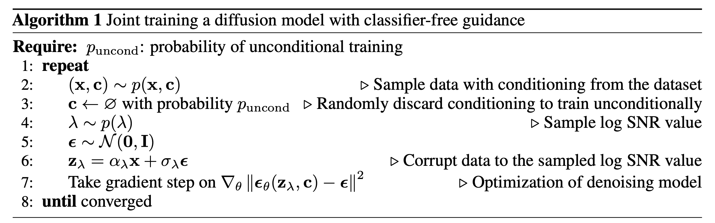
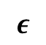
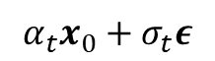
Conditional diffusion models
Training of conditional diffusion models
$$α_{t}x_{0}+σ_{t}ε$$
$$ε$$

